Slide 1
Multimodal Sensor Fusion and Co-Attention Strategies for Precision Gas Detection
MMIE 2024
Notes:
這個研究主要是在探討如何結合多模態資料以提升氣體辨識的準確度

Slide 2
Outline
Introduction
Methodology
Experiment
Conclusion

Slide 3
Introduction
Background
Fusion type

Slide 4
Introduction
Background
The detection of gas leakages is a crucial aspect to be considered in the chemical industries, coal mines, home applications, etc.
The low-cost sensors are generally less sensitive and less reliable; hence, they are unable to detect the gases from a longer distance.
Challenge
Unimodal
Multimodal learning
Notes:
首先是background的部分，氣體洩漏的這個議題不管是石油化學產業，或是家庭應用方面
那目前使用的這種低成本senosr，除較不敏感外，還無法監控到距離較遠或濃度較低的氣體
於是目前有越來越多的研究式朝多模態的方向去發展，那接下來就會介紹本研究是如何結合不同模態

Slide 5
Introduction
Decision
Decision
Fusion type
Decision
Decision
Early fusion
Late fusion
Fusion Type | Strength | Weakness
Early fusion (Stahlschmidt (2022)) | No design choices about how to extract marginal representations | Ignore the modality from which a feature originates.
Late fusion (Stahlschmidt (2022)) | Able to model heterogeneous modalities | Unable to learn interactions between features of different modalities
Notes:
重新整
‘marginal’ intermediate fusion, in which marginal representations are concatenated and directly input to a classifier, and ‘joint’ intermediate fusion in which more abstract joint features are learned.
We categorize these methods as intermediate fusion because the inputs to the fusion layers are features, whereas late fusion is defined as the fusion of decisions by sub-models
‘Marginal representation’ is defined as the result of a transformation of unimodal input data, ideally in such a way that latent useful factors are discovered.
A ‘joint representation’ consists of features that represent latent factors that are based on multiple modalities, thus encoding information that might be complementary, redundant or cooperative.
Early
However, this approach might not be able to identify relationships between the modalities when they only become apparent at higher levels of abstraction, because marginal representations are not explicitly learned
cross-modality and within-modality correlations are learned simultaneously at a low-level of abstraction.
By modeling a joint representation directly, finding useful marginal representations of each modality is hindered
Inter
Marginal representations of each modality are learned to discover within-modality correlations before using these to either learn joint representations or make prediction directly

Slide 6
Introduction
Fusion type
Decision
Decision
Intermediate fusion
Marginal representations of each modality are learned to discover within-modality correlations before using these to either learn joint representations or make prediction directly
Two type
Joint intermediate fusion(right)
marginal intermediate fusion(left)
Notes:
我們的模型有點像把img視為2個模態
Joint 分2種 用轉化
Inter
Marginal representations of each modality are learned to discover within-modality correlations before using these to either learn joint representations or make prediction directly
Marginal homogeneous fusion
the complexity of the model is reduced which lowers the risk of overfitting
by having separate branches, interpretability-enhancing methods can be chosen according to each modality. Additionally, as described, handling feature imbalance, missing modalities and coordinated representation learning are advantages of intermediate fusion approaches

Slide 7
Introduction
Fusion type
Decision
Decision
Intermediate fusion
Joint intermediate fusion(right)
marginal intermediate fusion(left)
Notes:
我們的模型有點像把img視為2個模態
Joint 分2種 用轉化
Inter
Marginal representations of each modality are learned to discover within-modality correlations before using these to either learn joint representations or make prediction directly
Marginal homogeneous fusion
the complexity of the model is reduced which lowers the risk of overfitting
by having separate branches, interpretability-enhancing methods can be chosen according to each modality. Additionally, as described, handling feature imbalance, missing modalities and coordinated representation learning are advantages of intermediate fusion approaches

Slide 8
Methodology
Dataset
Image to sequence
Model

Slide 9
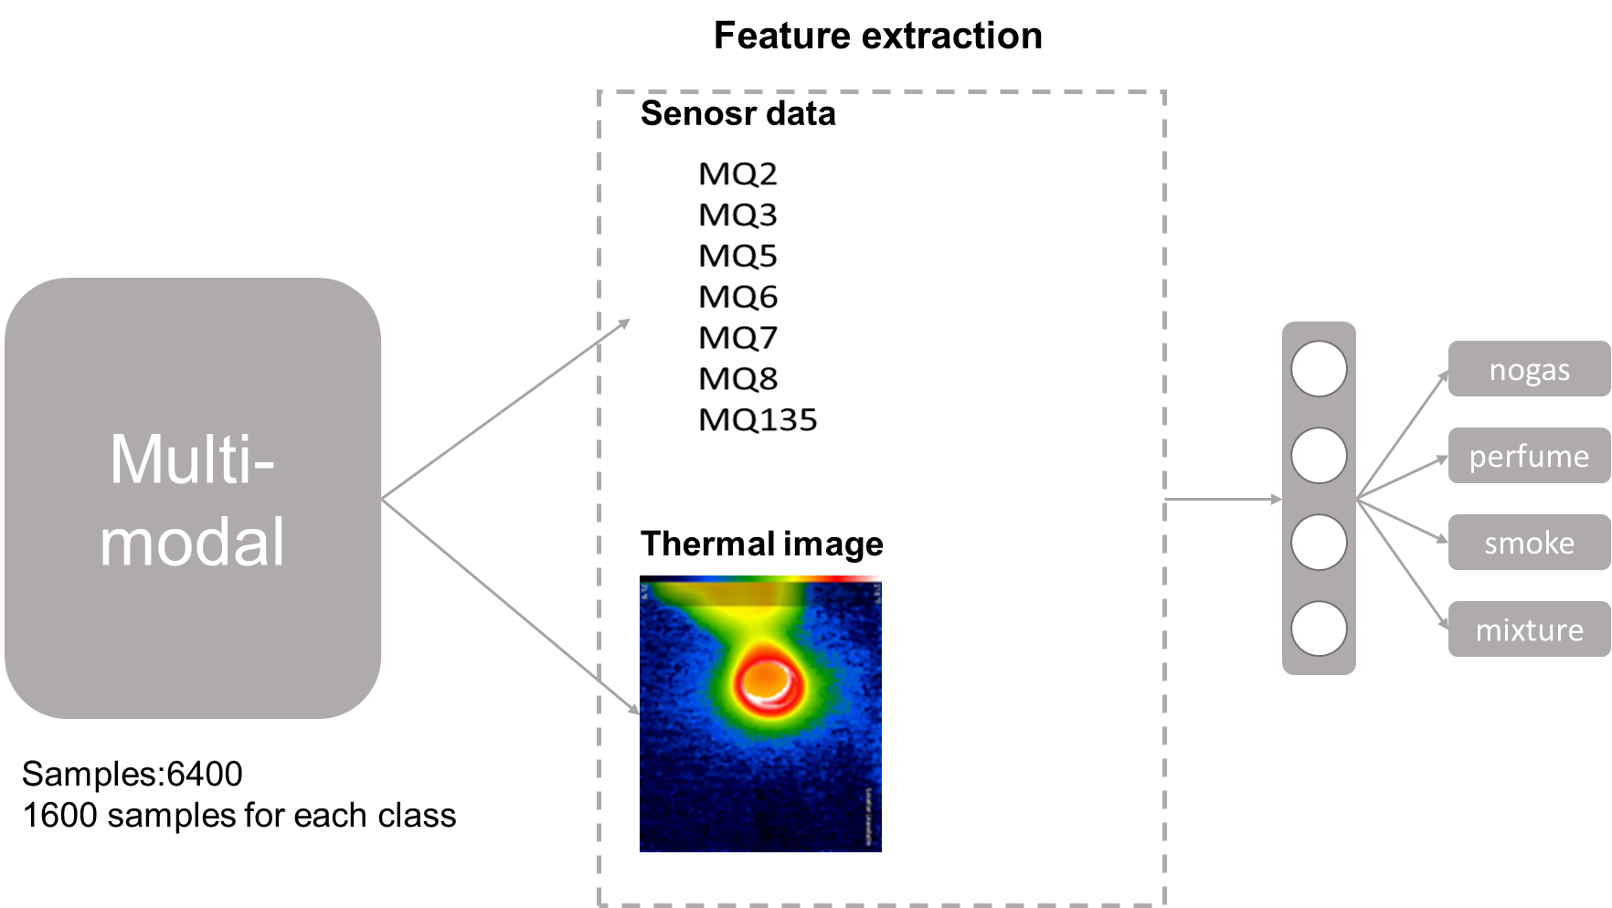
Methodology
Dataset
The MultimodalGasData dataset presented in this work is gathered through a variety of seven gas sensors along with utilizing the thermal camera.
the dataset is generated using two gas sources: namely, perfume and smoke. The data are logged at a frequency of 2 s continuously for the duration of 90 min.
This dataset has 6400 samples in total. For each class(no gas, perfume, smoke, mixture) containing 1600 samples.
Notes:
先簡單介紹這個資料集
這個資料集分成2種模態7個sensor的感測器資料和其對應的熱成像儀
實驗設計的部分
在一個密閉的環境內做實驗，氣體源分為：煙和香水
smoke產生一氧化碳、二氧化碳、二氧化氮、二氧化硫以及少量其他氣體的混合物
perfume產生酒精
會在這個環境分為4種gas type去做預測，分別是沒有氣體、香水、煙霧、和2者混合，每種環境都記錄1600筆資料
那主要目標就是去預測對應的環境，提升辨識氣體的準確率

Slide 10
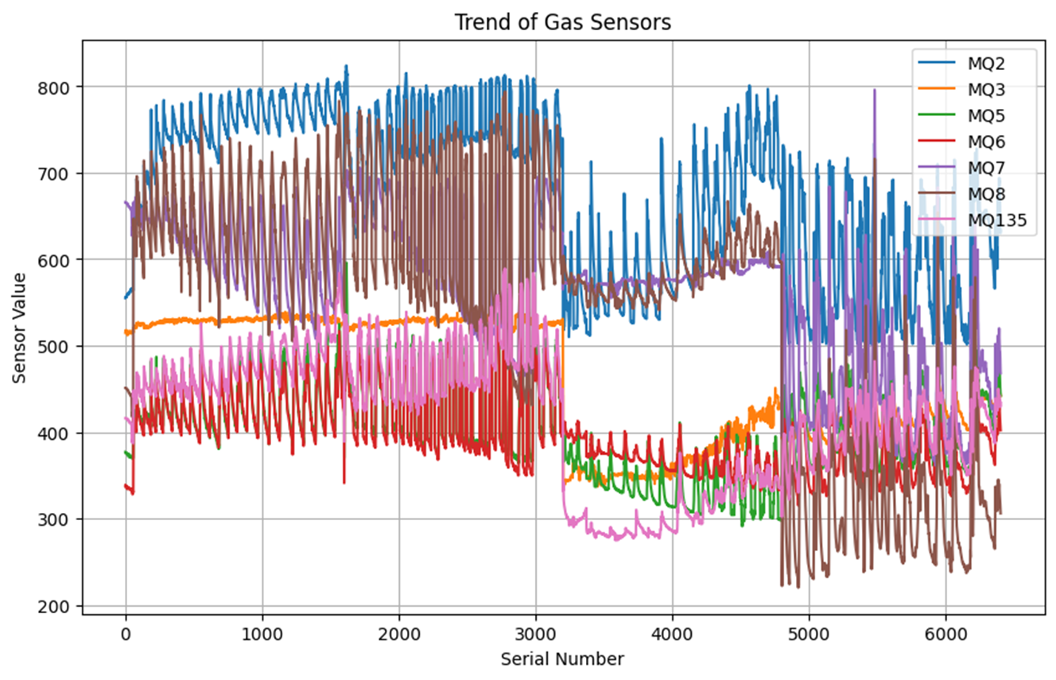
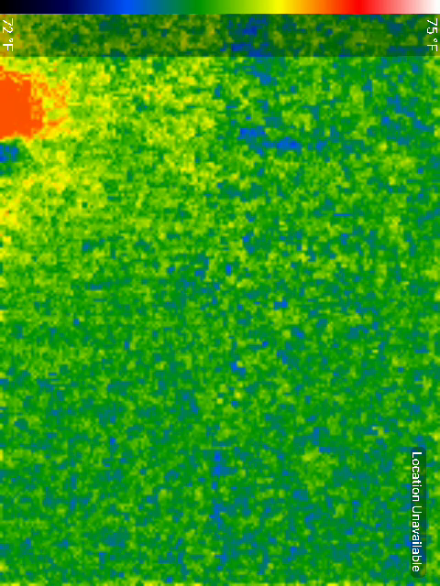
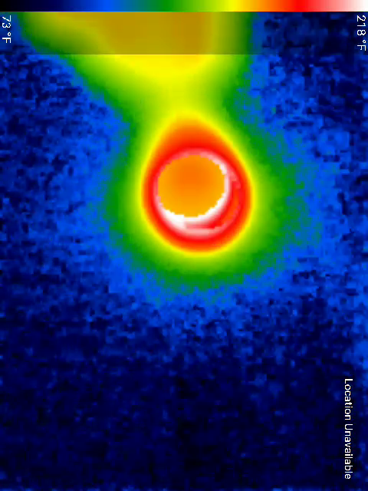
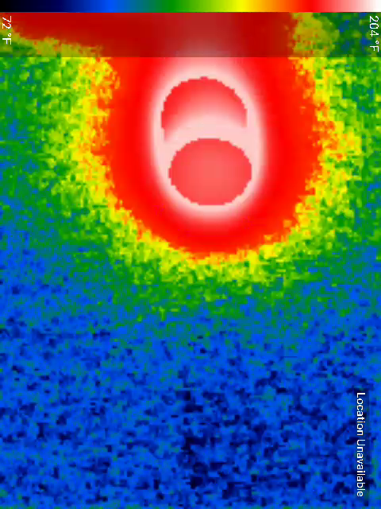
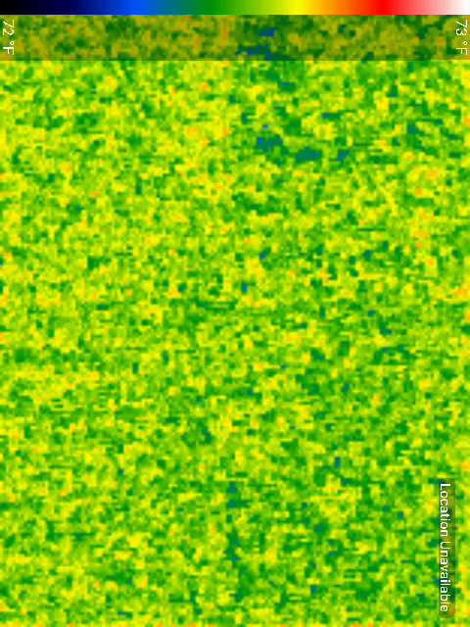
Methodology
Image to sequence
In this study, we added a temporal dimension, meaning that instead of looking at a single data point, we are now examining a time series of data.
Model
For thermal image (2DCNN to 3DCNN)
3D CNN structure
time
Batch size
sequence
channel
height
weight
For sensor data
Transformer encoder
time
Notes:
首先第一種模型在sensor data部分是使用transformer encoder，那因為transformer包含時間維度，因此針對圖片資料也增加時間維度，因此針對圖片資料是使用3DCNN架構進行處理
這邊簡單展示一下輸入
圖片部分
首先第一個維度是batch_size,sequence,channel,height,weight
那因為要符合3DCNN的輸入也就是batch_size,channel,depth,height,weight
需要reshape維度，也就是seqence跟channel要交換，並把sequence視為深度的概念，可以想像成影片的呈現
那sensor data是使用batch_size,sequence,features輸入

Slide 11
Methodology
Image to sequence
In this study, we added a temporal dimension, meaning that instead of looking at a single data point, we are now examining a time series of data.
Model
For thermal image (2DCNN to 3DCNN)
3D CNN structure
time
Batch size
sequence
channel
height
weight
Batch size
channel
depth
sequence
height
weight
For sensor data
Transformer encoder
time
Batch size
sequence
features
Notes:
加conv2d->conv3d

Slide 12
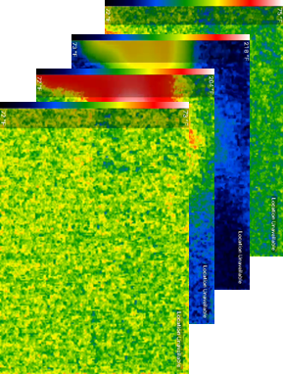
Introduction
For thermal image
3D CNN:
Captures shallow features
3D Res_block:
Captures deep features
Model-image
Decision
3D CNN
Conv3d
Maxpool3d
Features
Linear
Sensor data
Thermal image
Thermal image
Notes:
我們的模型有點像把img視為2個模態
Joint 分2種 用轉化
Inter
Marginal representations of each modality are learned to discover within-modality correlations before using these to either learn joint representations or make prediction directly
Marginal homogeneous fusion
the complexity of the model is reduced which lowers the risk of overfitting
by having separate branches, interpretability-enhancing methods can be chosen according to each modality. Additionally, as described, handling feature imbalance, missing modalities and coordinated representation learning are advantages of intermediate fusion approaches

Slide 13
Introduction
For thermal image
3D CNN:
Captures shallow features
3D Res_block:
Captures deep features
Model-image
Decision
3D CNN
Conv3d
Maxpool3d
Features
Linear
3D Res_block
Conv3d
BatchNorm3d
Basic block*2
Conv3d
Features
Layer1
BatchNorm3d
Layer2
Conv3d
Sensor data
Thermal image
Thermal image
Linear
BatchNorm3d
Shortcut
Notes:
我們的模型有點像把img視為2個模態
Joint 分2種 用轉化
Inter
Marginal representations of each modality are learned to discover within-modality correlations before using these to either learn joint representations or make prediction directly
Marginal homogeneous fusion
the complexity of the model is reduced which lowers the risk of overfitting
by having separate branches, interpretability-enhancing methods can be chosen according to each modality. Additionally, as described, handling feature imbalance, missing modalities and coordinated representation learning are advantages of intermediate fusion approaches

Slide 14
Introduction
For thermal image
3D CNN:
Captures shallow features
3D Res_block:
Captures deep features
Model-image
Decision
3D CNN
Conv3d
Maxpool3d
Features
concat
Linear
3D Res_block
Conv3d
BatchNorm3d
Basic block*2
Conv3d
Features
Layer1
BatchNorm3d
Layer2
Conv3d
Sensor data
Thermal image
Thermal image
Linear
BatchNorm3d
Shortcut
Notes:
我們的模型有點像把img視為2個模態
Joint 分2種 用轉化
Inter
Marginal representations of each modality are learned to discover within-modality correlations before using these to either learn joint representations or make prediction directly
Marginal homogeneous fusion
the complexity of the model is reduced which lowers the risk of overfitting
by having separate branches, interpretability-enhancing methods can be chosen according to each modality. Additionally, as described, handling feature imbalance, missing modalities and coordinated representation learning are advantages of intermediate fusion approaches

Slide 15
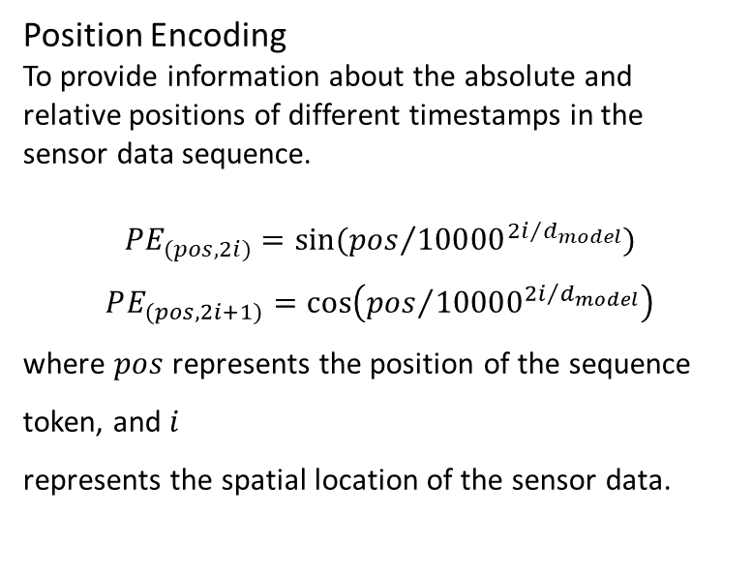
For sensor data
Transformer encoder:
Self-attention mechanism allows the model to capture the relationships between various positions.
Introduction
Model-sensor
Decision
Transformer encoder
Position Encoding
To provide information about the absolute and relative positions of different timestamps in the sensor data sequence.
$$PE_{(pos,2i)}=sin⁡({pos}/{{10000}^{{2i}/{d_{model}}}})$$
$$PE_{(pos,2i+1)}=\cos\left({pos}/{{10000}^{{2i}/{d_{model}}}}\right)$$
where $pos$represents the position of the sequence token, and$i$
represents the spatial location of the sensor data.
Add & Norm
concat
Feed
forward
Add & Norm
Multi-Head Attention
Positional Encoding
Input Embedding
Sensor data
Thermal image
Thermal image
Notes:
我們的模型有點像把img視為2個模態
Joint 分2種 用轉化
Inter
Marginal representations of each modality are learned to discover within-modality correlations before using these to either learn joint representations or make prediction directly
Marginal homogeneous fusion
the complexity of the model is reduced which lowers the risk of overfitting
by having separate branches, interpretability-enhancing methods can be chosen according to each modality. Additionally, as described, handling feature imbalance, missing modalities and coordinated representation learning are advantages of intermediate fusion approaches

Slide 16
For sensor data
Transformer encoder:
Self-attention mechanism allows the model to capture the relationships between various positions.
Introduction
Model-sensor
Decision
concat
Transformer encoder
Position Encoding
To provide information about the absolute and relative positions of different timestamps in the sensor data sequence.
$$PE_{(pos,2i)}=sin⁡({pos}/{{10000}^{{2i}/{d_{model}}}})$$
$$PE_{(pos,2i+1)}=\cos\left({pos}/{{10000}^{{2i}/{d_{model}}}}\right)$$
where $pos$represents the position of the sequence token, and$i$
represents the spatial location of the sensor data.
Add & Norm
concat
Feed
forward
Add & Norm
Multi-Head Attention
Positional Encoding
Input Embedding
Sensor data
Thermal image
Thermal image
Notes:
我們的模型有點像把img視為2個模態
Joint 分2種 用轉化
Inter
Marginal representations of each modality are learned to discover within-modality correlations before using these to either learn joint representations or make prediction directly
Marginal homogeneous fusion
the complexity of the model is reduced which lowers the risk of overfitting
by having separate branches, interpretability-enhancing methods can be chosen according to each modality. Additionally, as described, handling feature imbalance, missing modalities and coordinated representation learning are advantages of intermediate fusion approaches

Slide 17

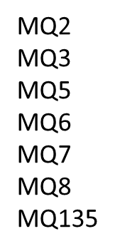
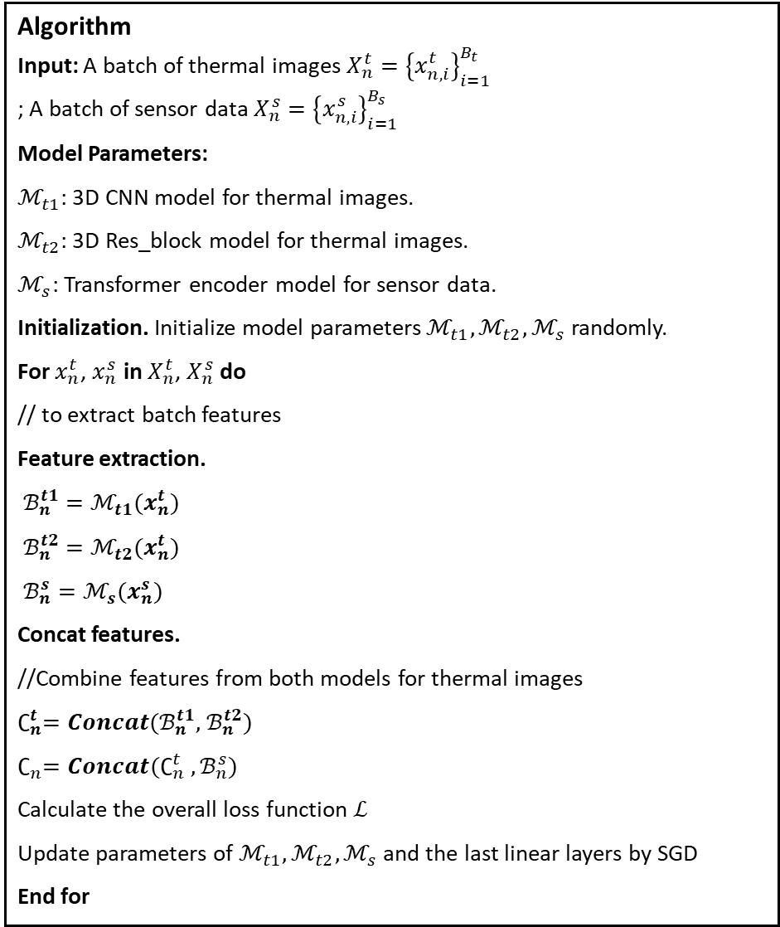
Algorithm
Input: A batch of thermal images $X_{n}^{t}={\left\{x_{n,i}^{t}\right\}}_{i=1}^{B_{t}}$
; A batch of sensor data $X_{n}^{s}={\left\{x_{n,i}^{s}\right\}}_{i=1}^{B_{s}}$
Model Parameters:
$ℳ_{t1}$: 3D CNN model for thermal images.
$ℳ_{t2}$: 3D Res_block model for thermal images.
$ℳ_{s}$: Transformer encoder model for sensor data.
Initialization. Initialize model parameters$ℳ_{t1},ℳ_{t2},ℳ_{s}$randomly.
For $x_{n}^{t}$, $x_{n}^{s}$ in $X_{n}^{t}$, $X_{n}^{s}$ do
// to extract batch features
Feature extraction.
$ℬ_{n}^{t1}=ℳ_{t1}(x_{n}^{t})$
$ℬ_{n}^{t2}=ℳ_{t2}(x_{n}^{t})$
$ℬ_{n}^{s}=ℳ_{s}(x_{n}^{s})$
Concat features.
//Combine features from both models for thermal images
$∁_{n}^{t}={Concat(ℬ}_{n}^{t1},$ $ℬ_{n}^{t2})$
$$∁_{n}{=Concat(∁}_{n}^{t} ,ℬ_{n}^{s})$$
Calculate the overall loss function $ℒ$
Update parameters of $ℳ_{t1},ℳ_{t2},ℳ_{s}$and the last linear layers by SGD
End for
Methodology
Cross-entropy loss
nn.linear
Concat
Features
Features
Concat
3D RESNET
3D CNN
TRANSFORMER
Notes:
Algorithmn
Img concat那邊也要寫
Concat定義notation

Slide 18
Experiment
Setting
Result

Slide 19
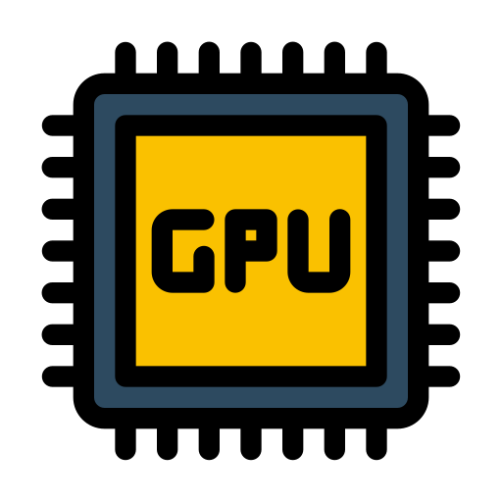


Experiment
Evaluation
Hyperparameters:
Setting
Evaluation matrix
Encoder:
Thermal image: CNN/Res_block
Sensor data: transformer encoder
GPU
TP
TN
FP
FN
Setting:
optimizer: SGD
Batch size: 16
Learning rate: 0.0005
Epochs:150
Lr scheduler: ReduceLROnPlateau
NVIDIA GeForce RTX 4090
Memory
Accuracy :
$$\frac{TP+TN}{TP+TN+FP+FN}$$
32GB RAM
Notes:
Setting要多寫一點

Slide 20

Experiment
Result
We compare our method against the unimodal baselines and the multimodal SOTA methods as follow:
Unimodal Baseline.
LSTM that has been used previously in time-series data, and CNN structure for thermal images.
Multimodal SOTA.
We compare some methods for gas classification including LSTM-CNN(different fusion type) and other ensemble models.
Notes:
Ablation study
3DCNN-Transformer
3DResnet-Transformer
3DCNN+3DResnet-Transformer
單一模態的比較
CNN 3DCNN

Slide 21
Ablation study
(a) Performance of traditional 2D CNN and 3D CNN with Temporal Dimension
(b) Performance of multimodal and unimodal in thermal image
(c) Performance of multimodal and unimodal
Notes:
Ablation study
3DCNN-Transformer
3DResnet-Transformer
3DCNN+3DResnet-Transformer
單一模態的比較
CNN 3DCNN

Slide 22
Conclusion
Contribution & Feature research

Slide 23
Conclusion
Contribution & Feature research
Contributions
Unimodal v.s. Multimodal
In this study, we used a multimodal approach to combine image data with sensor data for gas type prediction. Compared to using a single modality, the accuracy can be improved by 1.3%.
Features extraction on thermal images
we incorporated the concept of a temporal dimension by using two 3D CNN-based models for feature extraction. Compared to using a single model, this approach allows us to capture features at different levels, resulting in better performance.
Feature research
We also attempted to use co-attention mechanisms to capture the relationships between the two modalities, but the results were not better. This is a direction that can be explored in future research.
Notes:
在本研究中，我們使用了多模態的方法將影像資料與感測器資料做結合來預測氣體種類，比起單一模太多模態準確率可以高出1.3%
在影像部分，我們增加了時間維度的概念使用3DCNN為基礎的2種模型來提取特徵，比起透過單一模型更能提取到不同層級的特徵，因此有較好的表現
我們也嘗試使用co-attention的方式去獲取2種模態的關聯性，但結果並沒有比較好，這也是未來可以在研究的方向

Slide 24
Reference
Stahlschmidt, S. R., Ulfenborg, B., & Synnergren, J. (2022). Multimodal deep learning for biomedical data fusion: a review. Briefings in Bioinformatics, 23(2), bbab569.
Narkhede, P., Walambe, R., Mandaokar, S., Chandel, P., Kotecha, K., & Ghinea, G. (2021). Gas detection and identification using multimodal artificial intelligence based sensor fusion. Applied System Innovation, 4(1), 3.
Rahate, A., Mandaokar, S., Chandel, P., Walambe, R., Ramanna, S., & Kotecha, K. (2023). Employing multimodal co-learning to evaluate the robustness of sensor fusion for industry 5.0 tasks. Soft Computing, 27(7), 4139-4155.
Attallah, O. (2023). Multitask deep learning-based pipeline for gas leakage detection via E-nose and thermal imaging multimodal fusion. Chemosensors, 11(7), 364.

